Slide 1


Social Buzz Data-set Analysis

Slide 2


Today's agenda
Project recap:
Problem
The Analytics team
Process
Insights
Summary

Slide 3

Project Recap
This project is on Social Buzz which is a fast-growing technology unicorn which is scaling up globally and needed assistance for the same. So, Accenture had begun a 3-month POC focusing on these tasks :
Conducting an audit of big data practices of Social Buzz
Successful IPO recommendation
Analysis to find top 5 popular content category

Slide 4

Problem
No. of posts per day is > 100000
No. of posts per year > 36500000
How to capitalize this and make it profitable?
find Social Buzz’s top 5 most popular content categories and makinf further analysis.

Slide 5



Andrew Fleming
Chief Technical Architect
The Analytics team
Marcus Rompton
Senior Principle
Mahik Gupta
Data Analyst

Slide 6
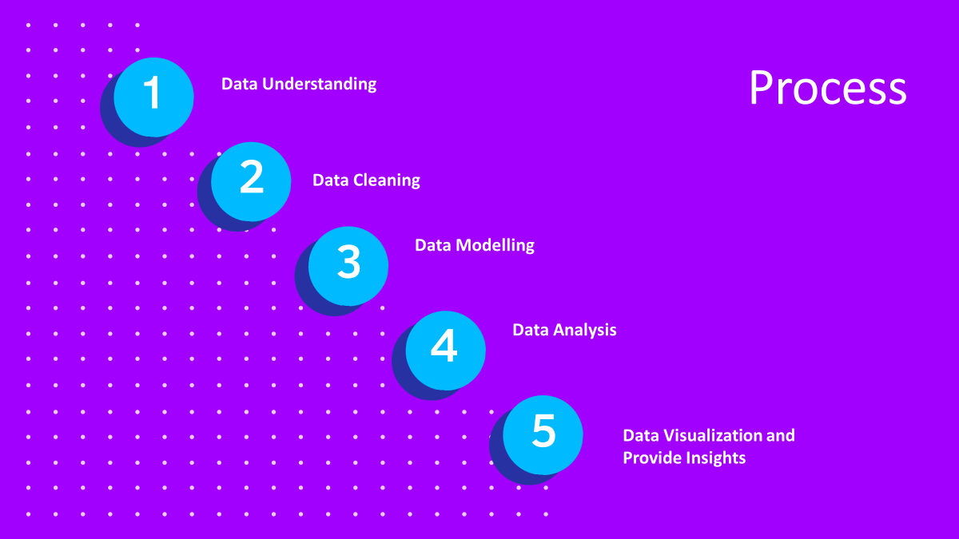

Slide 7


Slide 8
Insights
16
1897
MAY
Unique
Categories
Reactions to ANIMAL posts
Month with
MAX posts

Slide 11

The top 5 categories in descending order are:
Animals
Science
Healthy eating
Food
Technology
The category with the highest count is animals
The month with maximum number of posts is the month of may
Summary

Slide 12
Thank you!
ANY QUESTIONS?

